Slide 1
CG_Hadoop: Computational Geometry in MapReduce
Ahmed Eldawy* Yuan Li* Mohamed F. Mokbel*$ Ravi Janardan*
* Department of Computer Science and Engineering, University of Minnesota
$ KACST GIS Technology Innovation Center, Umm Al-Qura University

Slide 2
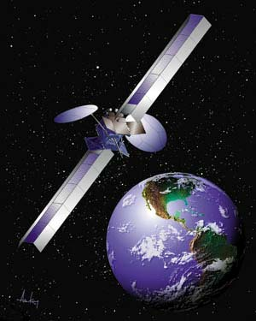
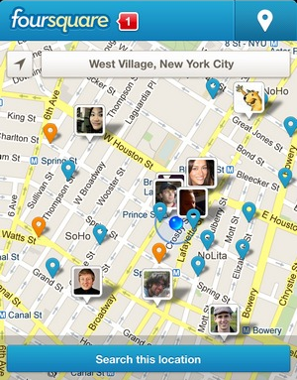
Big Spatial Data
Satellite Imagery
Geotagged Tweets
Check ins
More than ~500TB
Billions of tweets
Billions of check ins
Millions more every day
Notes:
NASA data: ~575 Terabytes in volume (as of April 30, 2011) [https://lpdaac.usgs.gov/products/modis_products_table]
OSM: 400GB [http://wiki.openstreetmap.org/wiki/Planet.osm]
Geotagged tweets: Billions [https://blog.twitter.com/2013/the-geography-of-tweets]
4sq checkins: Over 4.5 billion check-ins, with millions more every day [https://foursquare.com/about] (Updated September 2013)

Slide 3
SpatialHadoop
A MapReduce framework tailored for spatial data
Free open source [http://spatialhadoop.cs.um.edu/]
More than 40,000 downloads since the initial release
Supports spatial data types
E.g., Point, Rectangle and Polygon
Provides spatial partitioning and indexing for spatial data
Grid file
R-tree
R+-tree
Efficient MapReduce operations for spatial queries

Slide 4
CG_Hadoop
Make use of SpatialHadoop to speedup computational geometry algorithms
Polygon union, Skyline, Convex Hull, Farthest/Closest Pair
Single machine implementation
E.g., Skyline of 4 billion points takes three hours
Straight forward implementation in Hadoop
Hadoop parallel execution
More efficient implementation in SpatialHadoop
Spatial indexing
Early pruning
Free open source [http://spatialhadoop.cs.umn.edu/]
260x
29x
1x
Single Machine
Spatial Hadoop
Hadoop

Slide 5
Agenda
Motivation
Overview
CG_Hadoop
General Methodology
Polygon union
Skyline
Convex Hull
Farthest Pair
Closest Pair
Experiments
Conclusion

Slide 6
General Methodology
All algorithms in CG_Hadoop employ a divide and conquer approach
1. Partition the input using Hadoop/SpatialHadoop partitioner
2. (Optional) prune partitions that do not contribute to answer
3. Apply the algorithm locally in each partition
4. Combine the partial answers to compute the final result

Slide 7
Example: Partitioning of 400 GB OSM Data

Slide 8
Polygon Union
Compute the union of a set of polygons
Input
Output

Slide 9
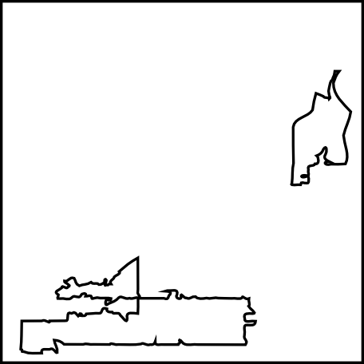
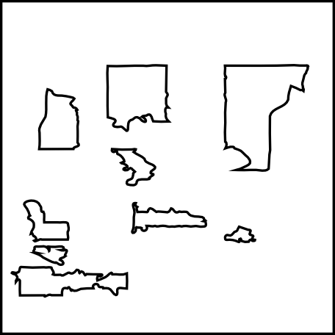
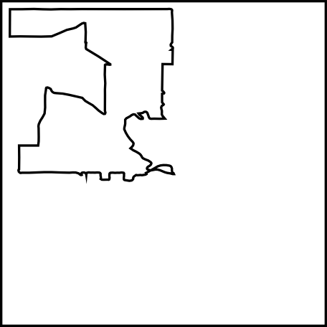
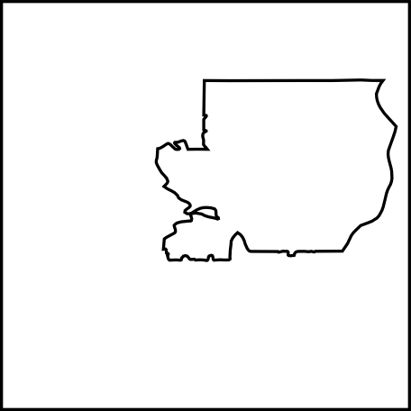
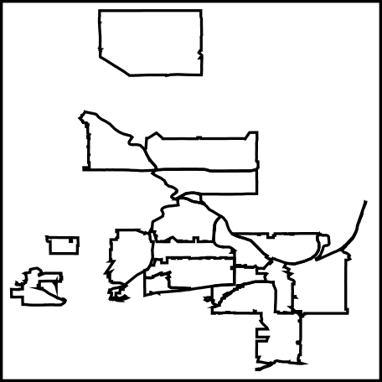
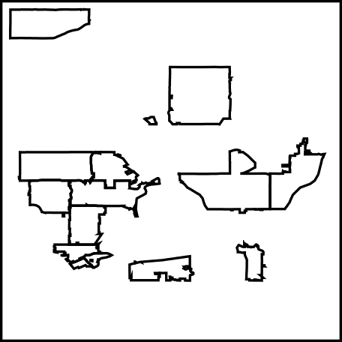
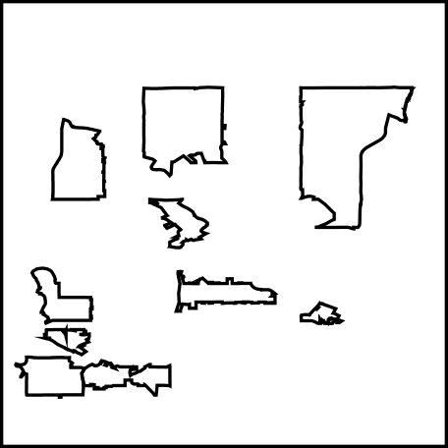
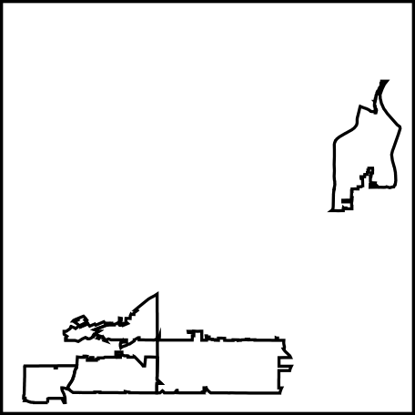
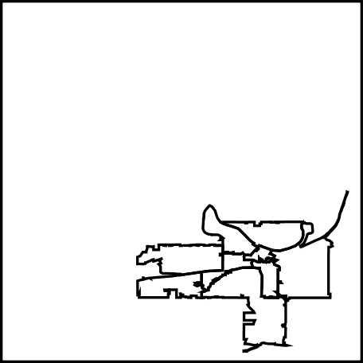
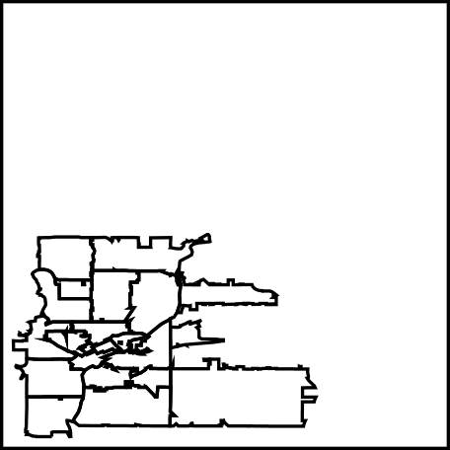
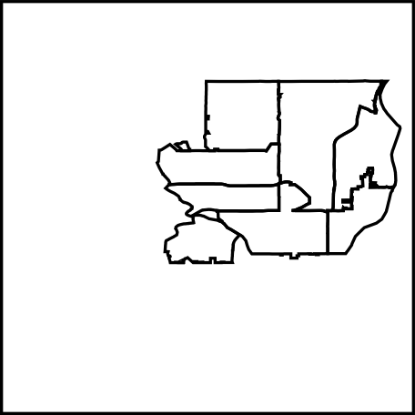
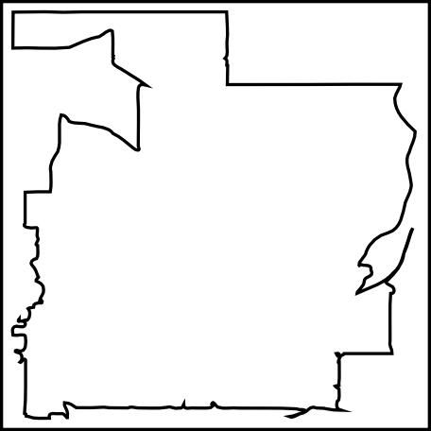
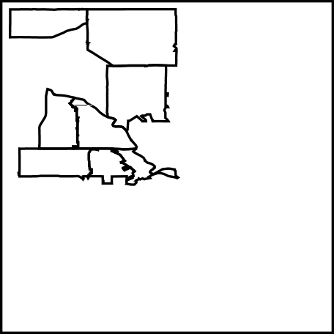
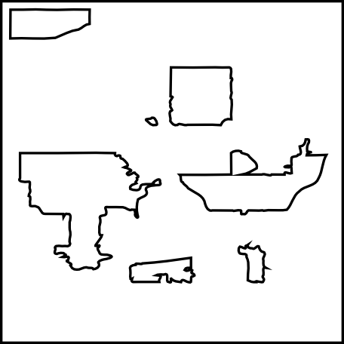
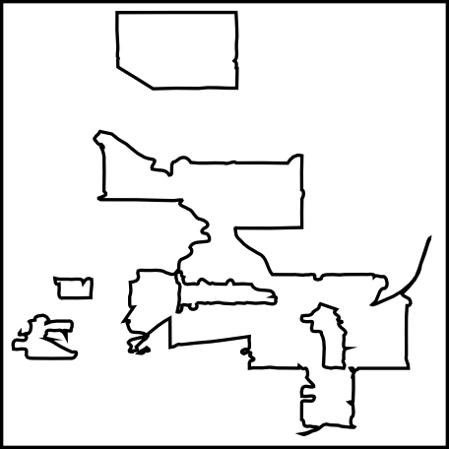
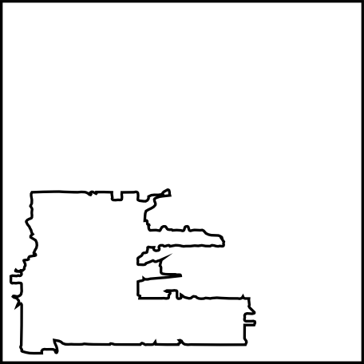
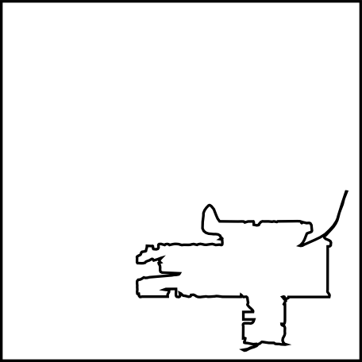
Polygon Union in CG_Hadoop
Hadoop
SpatialHadoop
①Partition
② Local union
③ Global union

Slide 10
Skyline (Maximal Vectors)
Select all non-dominated points in a set of points
Input
Output

Slide 11
Skyline in CG_Hadoop
Hadoop
SpatialHadoop
①Partition
②Pruning
③Local skyline
④Global skyline

Slide 12
Convex Hull
Find the minimal convex polygon that contains all points
Input
Output

Slide 13
Convex Hull in CG_Hadoop
Hadoop
SpatialHadoop
①Partition
②Pruning
③Local hull
④Global hull

Slide 14
Farthest Pair
Find the pair of points that have the largest Euclidean distance
Input
Output

Slide 15
Farthest Pair in CG_Hadoop
Hadoop
SpatialHadoop
①Partition
②Pruning
③Local farthest pair
④Global farthest pair

Slide 16
Closest Pair
Find the pair of points that have the shortest Euclidean distance
Input
Output

Slide 17
Closest Pair in CG_Hadoop
Hadoop
SpatialHadoop
①Partition
② Local closest pair
③ Global closest pair

Slide 18
Experiments
Apache Hadoop/SpatialHadoop 1.2.0
Java 1.6
A cluster of 25 nodes
Dual core
4 GB RAM
Single machine
Eight cores
16 GB RAM
Real datasets from OpenStreetMap
OSM1: 164 Million polygons, total size of 80GB
OSM2: 1.7 Billion points, total size of 52GB
Synthetic dataset of up to 3.8 Billion points, total size of 128GB

Slide 19
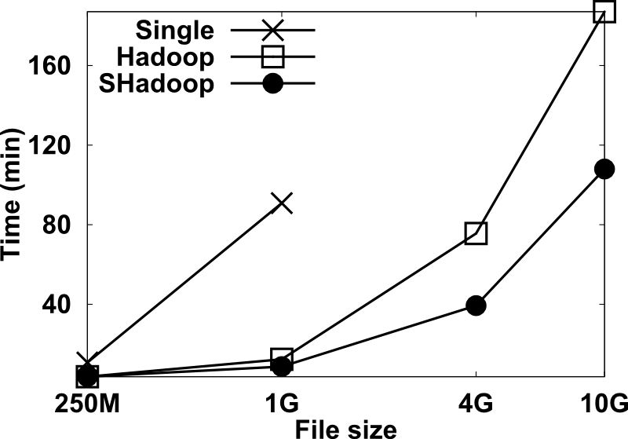
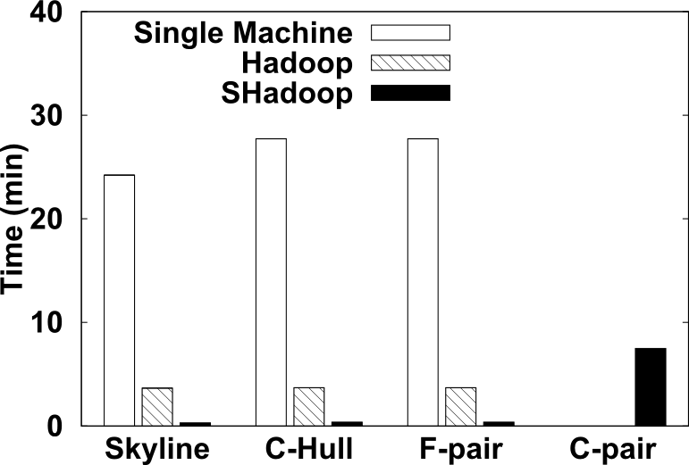
Real datasets
OSM1 (Polygon Union)
OSM2 (Others)

Slide 20
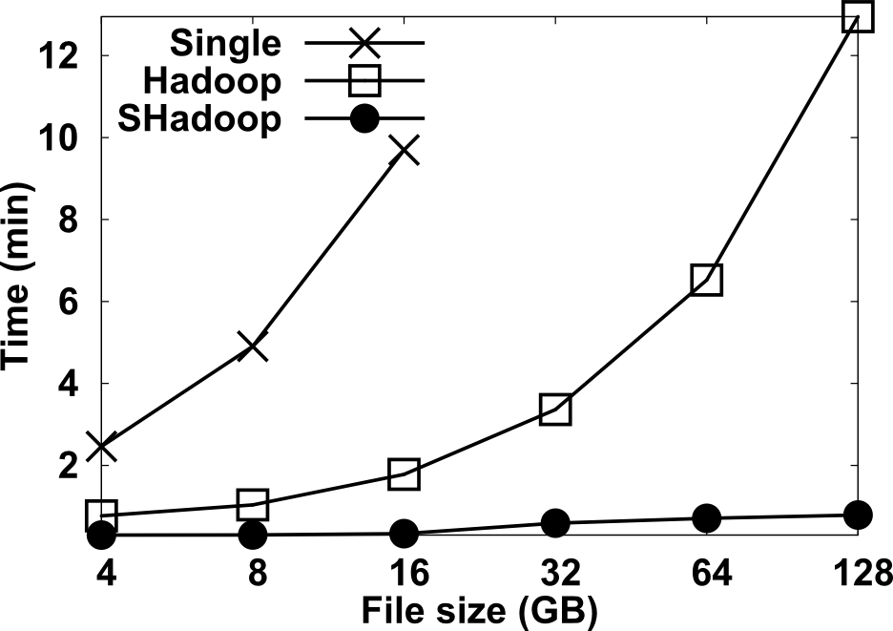
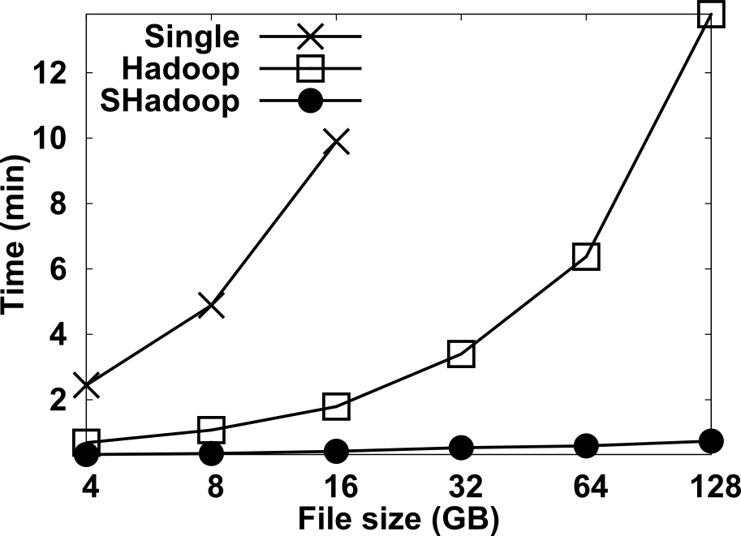
Skyline
Negatively correlated data
Positively correlated data

Slide 21
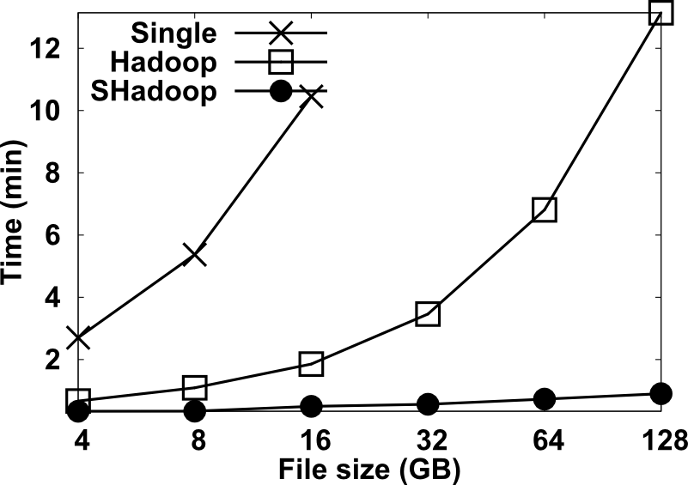
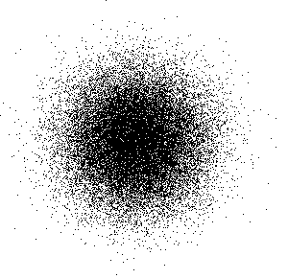
Convex Hull
Uniform data
Gaussian data

Slide 22
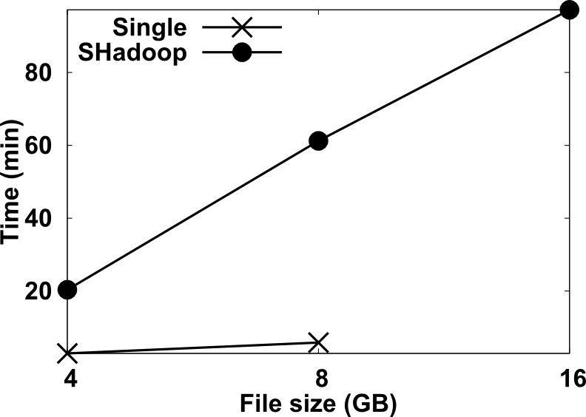
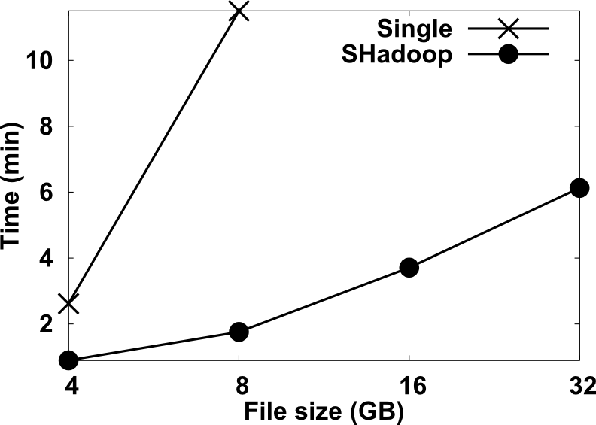
Farthest/Closest Pair
Farthest Pair
Closest Pair
Circular data
Uniform data

Slide 23
Conclusion
CG_Hadoop is a suite of scalable MapReduce algorithms for computational geometry problems
Implemented in both Hadoop and SpatialHadoop
Distributed processing in Hadoop speeds up query answering
SpatialHadoop spatial partitioning makes it more efficient
Extensive experiments on both real and synthetic data show the scalability and efficiency of CG_Hadoop

Slide 24
Thank you!
Questions?

