Slide 1
SpatialHadoop
Towards Flexible and Scalable
Spatial Processing using MapReduce http://spatialhadoop.cs.umn.edu/
@spatialhadoop
PhD student: Ahmed Eldawy
Advisor: Prof. Mohamed Mokbel

Slide 2

Hadoop
Hadoop is a MapReduce framework for huge data
processing
Motivated by the huge
datasets that need
to be analyzed
Widely adopted in many applications
  Tera-byte sorting
  Graph processing
  Machine learning
  Behavioral simulation

Slide 3



Spatial data
Increasing amounts of spatial data
Unfortunately…
Hadoop is ill equipped
for spatial data processing
Smart phones
Satellite Images
Medical data

Slide 4


Example
Spatial range query in Hadoop
Spatial range query in SpatialHadoop
edges = LOAD ’edges’ AS (id:int, x1:int, y1:int,
x2:int, y2:int);
selected_edges = FILTER edges BY
x1 < xmax AND xmin < x2 AND
y1 < ymax AND ymin < y2;
Takes 193
seconds
edges = LOAD ’edges’ AS (id:int, edge_mbr:rectangle);
seleced_edges = FILTER edges BY
Overlap(edge_mbr, rectangle(xmin, ymin, xmax, ymax));
Finishes
in 2 sec

Slide 5

SpatialHadoop
A full-fledged system for spatial data
Efficient
  Low level support for spatial data
User friendly
  Provides a simple high level language
Highly scalable
  To tens of thousands of nodes and terabytes of data
Flexible
  Open source. Downloaded more than 75,000 times
  Researchers can add new spatial operations
A. Eldawy and M. F. Mokbel. A Demonstration of SpatialHadoop: An Efficient MapReduce Framework for Spatial Data. In VLDB, 2013.

Slide 6
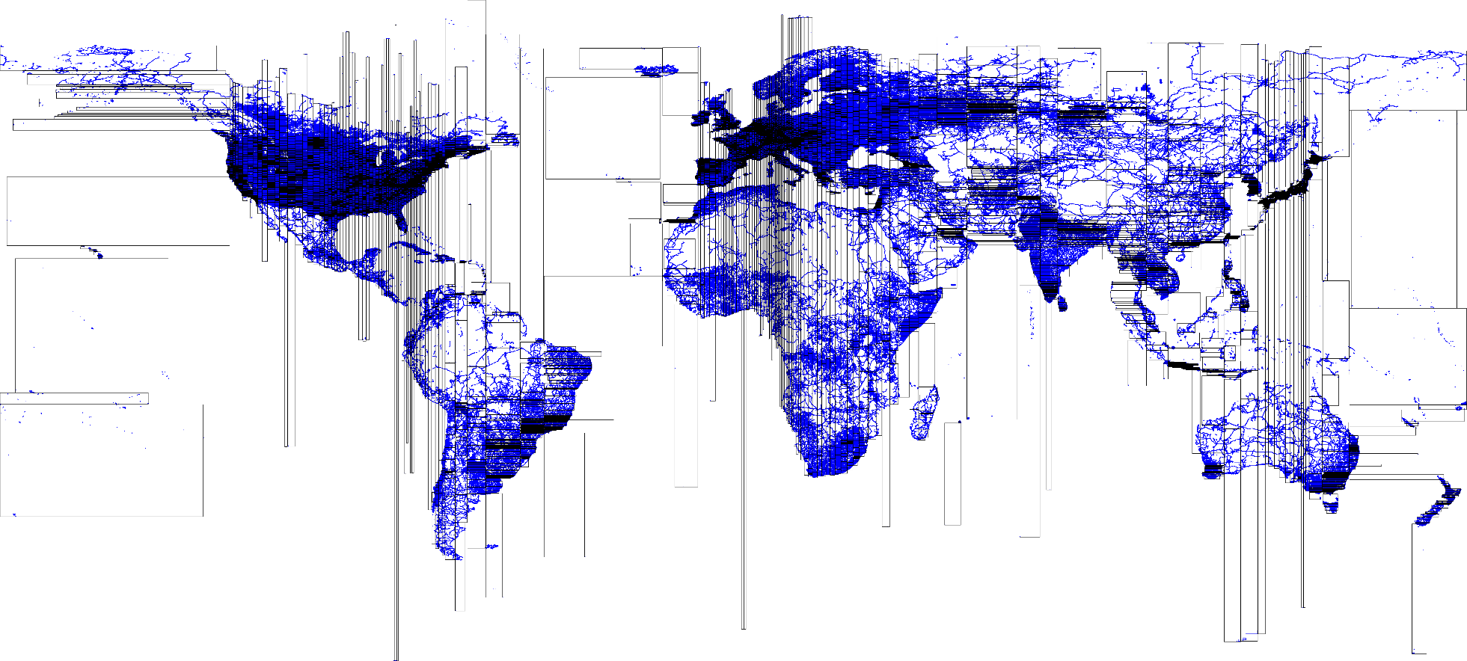
Example: Partitioning of 400 GB OSM Data

Slide 7


SpatialHadoop Architecture
Applications: MNTG [SSTD’13, ICDE’14] – SHAHED
TAREEG [SIGMOD’14]
Language: Pigeon [ICDE’14]
Operations: Basic [VLDB’13] – CG_Hadoop [SIGSPATIAL’13]
Data Mining – Visualization
Spatio-temporal Hadoop
MapReduce: Spatial File Splitter – Spatial Record Reader
Indexing: Grid File – R-tree – R+-tree

Slide 8
Language Layer: Pigeon
Applications
Language: Pigeon
Operations Layer
Spatio-temporal Hadoop
MapReduce Layer
Indexing Layer

Slide 9

Pigeon
Hides the complexity of the system with a high level language
Extends Pig Latin with OGC-compliant primitives
  Spatial data types (e.g., Polygon)
  Basic operations (e.g., Area)
  Spatial predicates (e.g., Touches)
  Spatial analysis (e.g., Union)
  Spatial aggregate functions (e.g., Convex Hull)
A. Eldawy and M. F. Mokbel. Pigeon: A Spatial MapReduce Language. In ICDE, 2014

Slide 10
Example
Find the city with largest area
cities = LOAD ’cities’
AS (city_id: int, city_geom);
City_area = FOREACH cities
GENERATE Area(city_geom) AS area;
Ordered_cities =
ORDER city area BY area DESC;
Largest_city =
LIMIT ordered_cities 1;

Slide 11
Indexing
Applications
Language Layer: Pigeon
Operations Layer
Spatio-temporal Hadoop
MapReduce Layer
Indexing Layer: Grid File – R-tree – R+-tree

Slide 12
Storage Layer
Hadoop works mainly with non-indexed heap files
Sufficient for traditional operations
Spatial operations need indexes
Traditional spatial indexes are not directly applicable in Hadoop due to
  HDFS limitations: Write once, append only
  Different programming paradigm: MapReduce Vs Procedural

Slide 13
Index Structure
HDFS Blocks
Data Nodes
Global Index
Local Indexes

Slide 14

Index Building - Partitioning
Number of partitions = Number of blocks
  $n=\frac{Expected size}{block capacity}$
Find partitions
  Grid
  R-tree
    Read a sample
    Insert into a temp R-tree
    MBRs of leaf nodes
Copy each record
to its partition(s)

Slide 15
Index Building – Local → Global
Build local
indexes
in memory
Store to
Files
Concat
Global Index

Slide 16
MapReduce Layer
Applications
Language: Pigeon
Operations Layer
Spatio-temporal Hadoop
MapReduce: Spatial File Splitter – Spatial Record Reader
Indexing Layer

Slide 17
MapReduce Layer
MapReduce layer in Hadoop is designed to work with heap files as input
Spatial operations in SpatialHadoop work with indexed files as input
SpatialHadoop introduces two new components:
  SpatialFileSplitter: Exploits global index
  SpatialRecordReader: Exploits local index

Slide 18
Map Phase in SpatialHadoop
Map task
Spatial
Record
Reader
Map
Split
Spatial
File
Splitter
Map task
Filter
Function
Spatial
Record
Reader
Map
Split

Slide 19
Operations Layer
Applications
Language: Pigeon
Operations: Basic – CG_Hadoop – Data Mining – Visualization
Spatio-temporal Hadoop
MapReduce Layer
Indexing Layer

Slide 20
Operations Layer
Spatial operations are implemented as MapReduce programs
New components are utilized
Basic Operations
  Range query, KNN, Spatial Join
Computation geometry operations
  Polygon Union, Skyline, Convex Hull, and Farthest/Closest pair
Other operations
  Visualization and Data Mining

Slide 21
Range Query
SpatialFileSplitter prunes blocks outside the query range
SpatialRecordReader passes local indexes to the map function
Map function selects records in range

Slide 22
Skyline (Maximal Vectors)
Select all non-dominated points in a set of points
Input
Output

Slide 23
Skyline in CG_Hadoop
Hadoop
SpatialHadoop
①Partition
②Pruning
③Local skyline
④Global skyline
A. Eldawy, Y. Li, M. F. Mokbel, and R. Janardan.
CG_Hadoop: Computational Geometry in MapReduce. In SIGSPATIAL, 2013

Slide 24
Applications
Applications: MNTG – SHAHED - TAREEG
Language: Pigeon
Operations Layer
Spatio-temporal Hadoop
MapReduce Layer
Indexing Layer

Slide 25
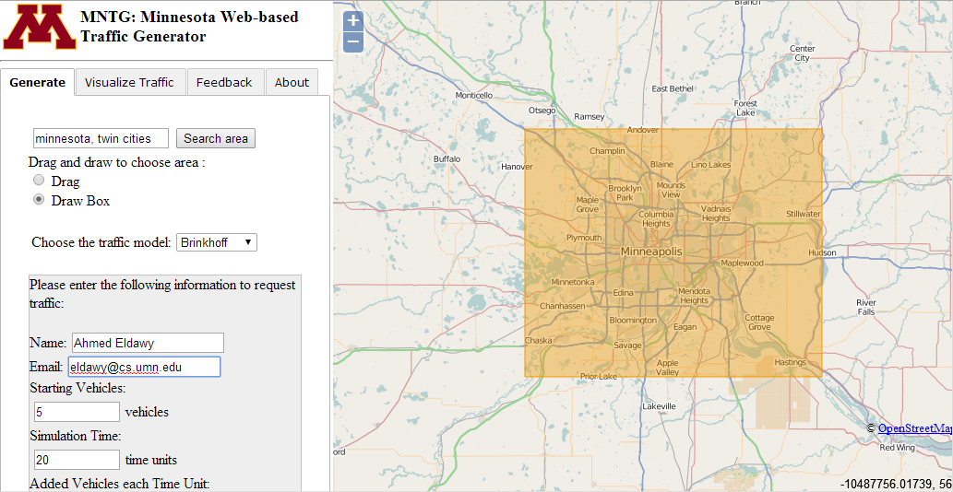
MNTG - World-wide traffic generator for road networks
http://mntg.cs.umn.edu/
M. F. Mokbel, L. Alarabi, J. Bao, A. Eldawy, A. Magdy, M. Sarwat, E. Waytas, and S. Yackel. MNTG: An Extensible Web-based Traffic Generator. In SSTD, 2013

Slide 26
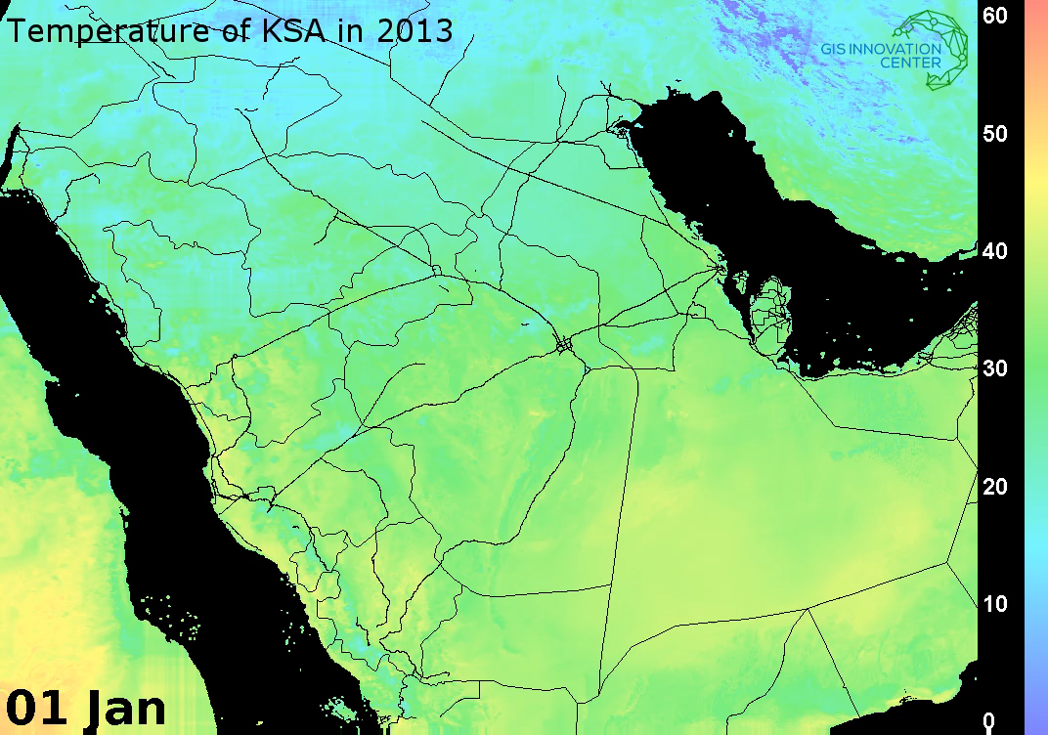
SHAHED – A tool for querying and visualizing spatio-temporal satellite data
Notes:
Generated from 40GB
Around 400 Million points

Slide 27
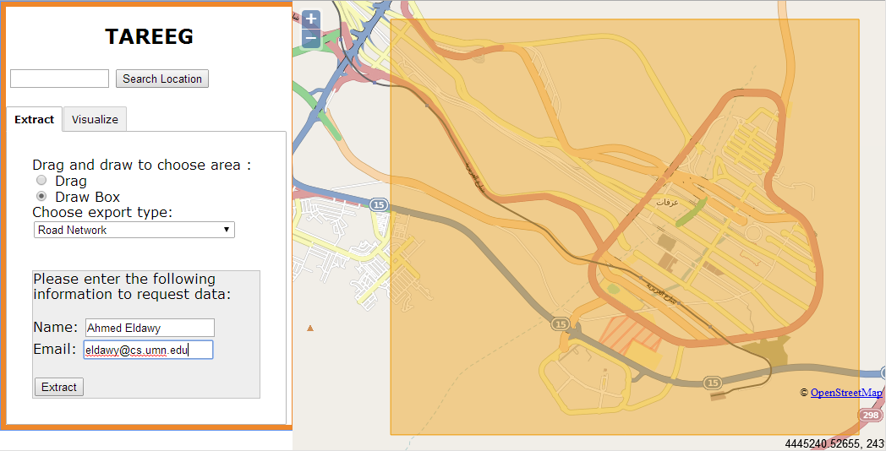
TAREEG – Web-based extractor for OpenStreetMap data based on MapReduce
http://tareeg.net/
L. Alarabi, A. Eldawy, R. Alghamdi, and M. F. Mokbel. TAREEG: A MapReduce-Based Web Service for Extracting Spatial Data from OpenStreetMap. In SIGMOD, 2014

Slide 28
Spatio-temporal Hadoop
Applications
Language: Pigeon
Operations Layer
Spatio-temporal Hadoop
MapReduce Layer
Indexing Layer

Slide 29
Spatio-temporal Hadoop
A simple extension to Hadoop to work with spatio-temporal data
Not as comprehensive as SpatialHadoop with spatial data, but it is a start

Slide 30
Spatio-temporal Index
2012
Jan
Feb
Mar
Dec
2013
1
2
3
…
31
…
Non indexed
Small Spatial Index
Large Spatial Index
(Grid file, R-tree, R+-tree)

Slide 31
Conclusion
SpatialHadoop is a full fledged system for spatial data processing
Pigeon is a spatial-aware high level language
Standard spatial indexes are adopted (Grid File, R-tree and R+-tree)
MapReduce layer is enriched for spatial MapReduce programs
Many spatial operations are shipped with SpatialHadoop. More can be added.
Already employed in three live systems
A simple extension can be added to work with Spatio-temporal data

Slide 32
Thank you

Slide 33
Reference Point

Slide 34
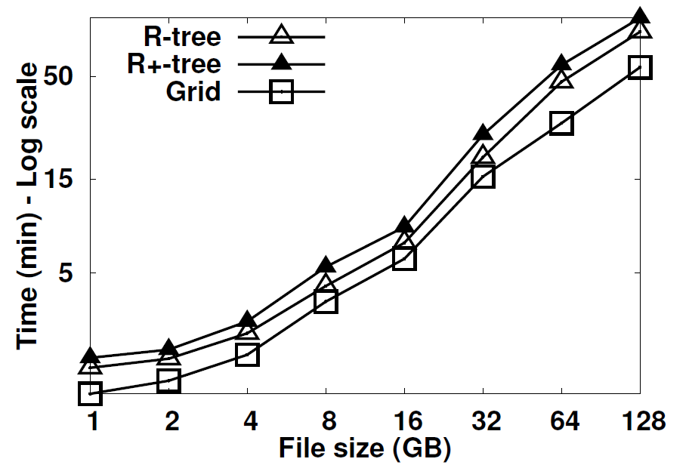
Index building

Slide 35
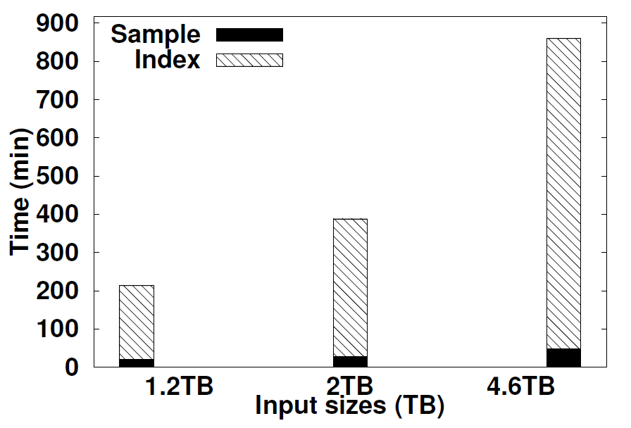
Index Building for NASA Data

Slide 36
Related Work
Most techniques for spatial data processing in Hadoop use Hadoop as a blackbox
  RQ, KNN and SJMR [Zhang et al’09]
  R-tree construction [Cary et al’09]
  KNN Join [Lu et al’12, Zhang et al’12]
  RNN [Akdogan et al’10]
  ANN [Wang et al’10]
MD-HBase [Nishimura et al’11]
  Framework for multi-dimensional data processing
  Based on HBase, a key-value store on HDFS
  Does not support MapReduce programming
Notes:
Shubin Zhang (chinese academy of science), J. Han, Z. Liu, K. Wang, and S. Feng. Spatial Queries Evaluation with MapReduce. In Proceedings of the International Conference on Grid and Cooperative Computing’09
A. Cary, Z. Sun, V. Hristidis, and N. Rishe. Experiences on Processing Spatial Data with MapReduce. SSDBM’09
Chi Zhang (Florida state), F. Li, and J. Jestes. Efficient Parallel kNN Joins for Large Data in MapReduce EDBT’12
W. Lu, Y. Shen, S. Chen, and B. C. Ooi. Efficient Processing of k Neareset Neighbor Joins using MapReduce, PVDLB’12
[RNN] A. Akdogan, U. Demiryurek, F. Banaei-Kashani, and C. Shahabi. Voronoi-based Geospatial Query Processing with MapReduce. In International Conference on Cloud Computing Technology and Science’10
K. Wang, J. Han, B. Tu, J. D. amd Wei Zhou, and X. Song. Accelerating Spatial Data Processing with MapReduce. In International Conference on Parallel and Distributed Systems’10
S. Nishimura, S. Das, D. Agrawal, and A. E. Abbadi. MD-HBase: A Scalable Multi-dimensional Data Infrastructure for Location Aware Services. MDM’11

Slide 37
Map plan – Hadoop
Map plan – SpatialHadoop
Input Heap
File
Map task
Indexed Input
File(s)
k,v
Number
of splits
Spatial
Record
Reader
Record
Reader
Map
Split
k,v
k,v
Spatial
File
Splitter
File
Splitter
…
Map task
k,v
Spatial
Record
Reader
Split
Record
Reader
k,v
Map
Filter
Function
k,v

Slide 38
KNN
SpatialFileSplitter selects the block that contains the query point
Map function performs kNN in the selected block
Answer is tested for correctness
✓ Answer is correct
k=3

Slide 39
KNN
First iteration runs as before and result is tested for correctness
✗ Answer is incorrect
Second iteration processes other blocks that might contain an answer
k=3

Slide 40
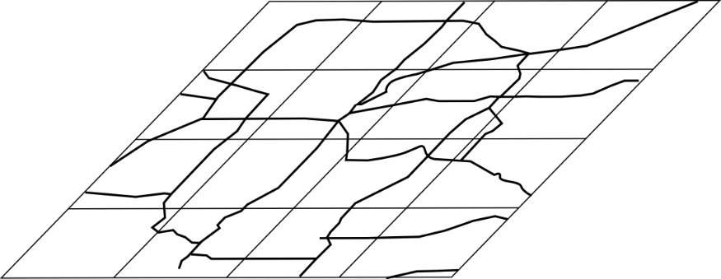

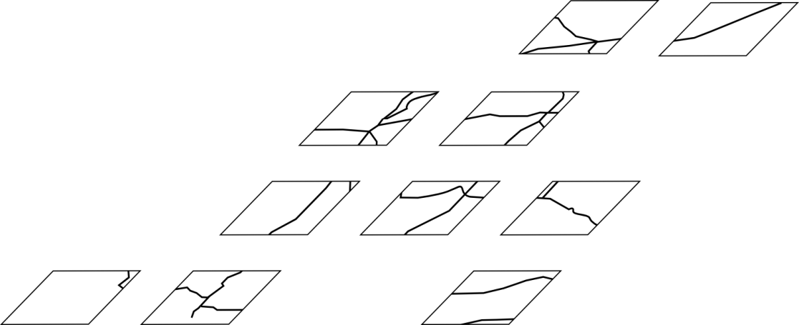

Spatial Join
Roads
SpatialFileSplitter find all overlapping pair of blocks
Rivers
Map function joins each pair of blocks
Overlapping
Blocks

Slide 41
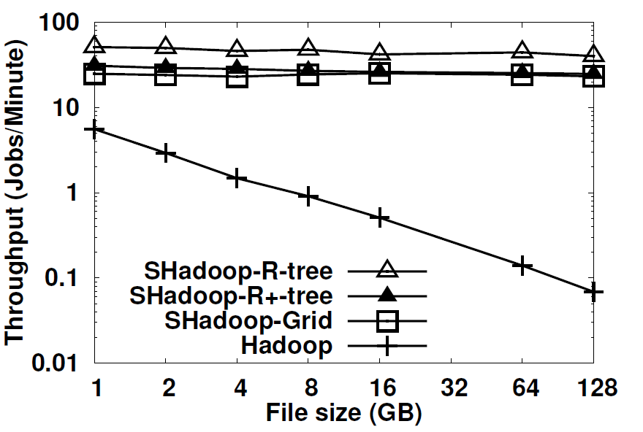
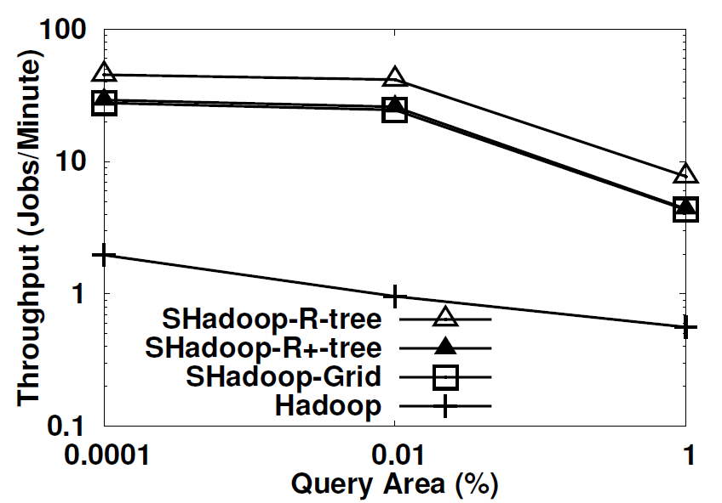
Range query

Slide 42
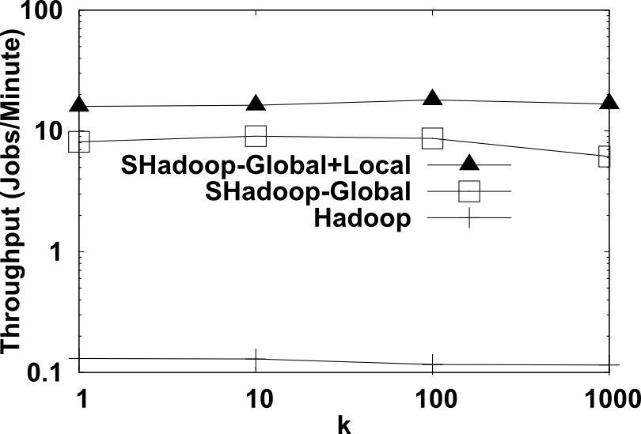
K Nearest Neighbor

Slide 43
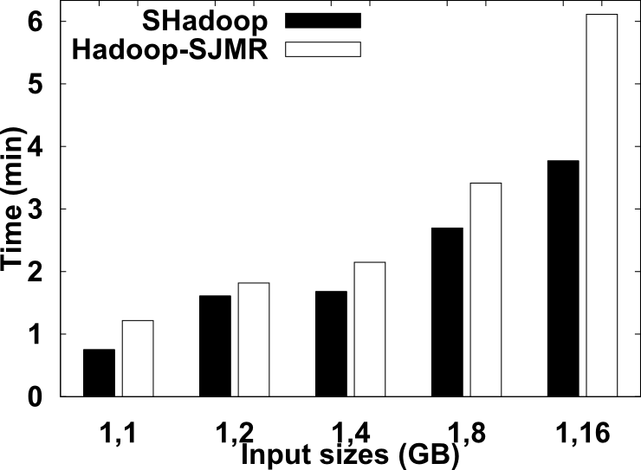
Spatial Join

